Slide 1
PHYSICAL LITERACY ACTION PLAN WORKSHOP

Slide 2
Overview
What is physical literacy?
What are the benefits of physical literacy to our school?
Identify and discuss how children can develop physical literacy through a quality HPE program across the whole school environment
How we can embed physical literacy
Understand the Physical Literacy: Guide for Schools
Create a physical literacy action plan
Sharing our ideas
Summary

Slide 3
What is physical literacy?
Physical literacy is about developing the skills, knowledge and behaviours that give children the confidence and motivation to lead active and healthy lives.
Physical literacy gives children:
physical skills and fitness
the attitudes and emotions that motivate them to be active
the social skills to be active with others
the knowledge and understanding of how, why and when they move
Watch the What is Physical Literacy? video
Watch the bring physical literacy to life in your school video
Notes:
Presenter notes:
Throughout this presentation to play videos and to click on any links you need to present this in ‘Slide Show’ mode.

Slide 4
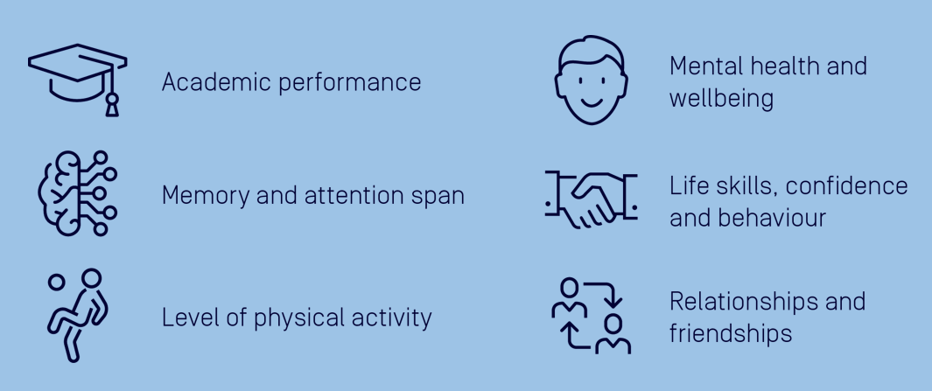
What are the benefits of physical literacy to our school?
Inspiration
Notes:
Presenter notes:
To help discussion in this section, refer to Physical Literacy: Benefits for Schools.

Slide 5
Whole school environment
Identify and discuss how students can develop physical literacy through the whole school environment:
Leadership
Policy
Environment
Quality health and physical education program
Inclusive co-curricular program
Cross-curricular approach
Families
Local communities.
Notes:
Presenter notes:
Highlight how physical literacy is developed through a quality HPE program, but there are other important areas of the school where physical literacy can also be embedded
Highlight how the whole school working together will have a much greater impact.

Slide 6
How we can embed physical literacy
This is the stage we are activating

Slide 7
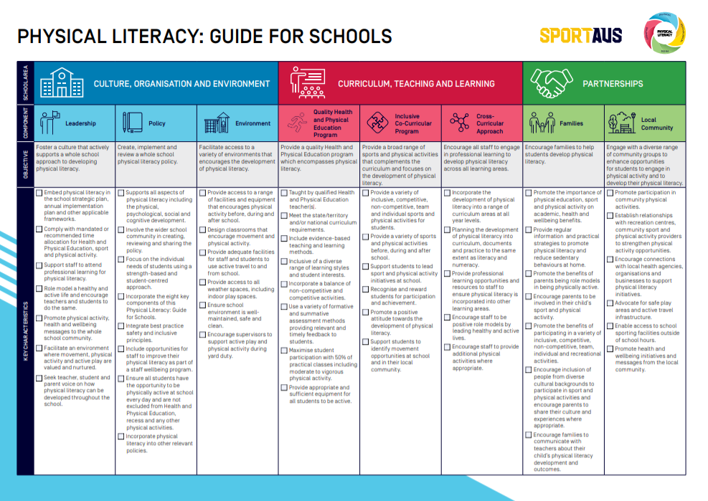
Understand the Physical Literacy: Guide for Schools
Take some time to review the Guide and understand the different sections:
School area – three broad sections of the school where physical literacy can be integrated.
Components – eight key focus areas within the school environment.
Objectives – the purpose of each component.
Key characteristics – actions that a school can undertake to embed physical literacy.

Slide 8
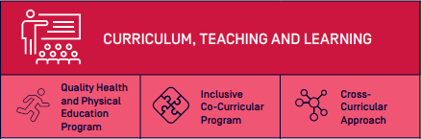
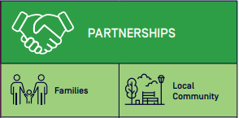
Understand the Physical Literacy: Guide for Schools
What are your thoughts on the three school areas?
Are any of the components connected in any way?
Are there components of the Guide that our school does well?

Slide 9
Create a physical literacy action plan
Break into three small groups and allocate one of the following school areas:
Culture, organisation and environment
Curriculum, teaching and learning
Partnerships
Each group is to work through the applicable action plan template and discuss:
What the school does well
Identify opportunities to build a stronger physical literacy culture
Complete the action plan template
Tip: Prioritise the key characteristics that will have the most impact for your school. Take a look at the Physical Literacy: Tips for Development for more ideas on how to develop each key characteristic.

Slide 10
Sharing our ideas
Each group shares their ideas with the larger group:
Discuss and review as a group
Make changes where required
Notes:
Presenter notes:
This is a great opportunity to review the ideas and to enhance them, so allow plenty of time for all group members to provide feedback.

Slide 11
Summary
Actions to be completed:
Templates will be collated into one document
A cover page introducing the action plan will be developed
Share action plan with:
Staff and student representative council (apply feedback)
Parents and citizen groups
Local sporting groups
Review action plan to reflect feedback
Schedule regular review dates to update action plan to reflect the changing school environment.

