Slide 1
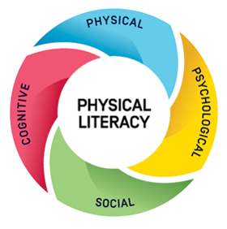
PHYSICAL LITERACY BENEFITS FOR SCHOOLS

Slide 2
Overview
Why physical literacy is important for schools
What is physical literacy?
Benefits for students
Benefits for schools
Alignment to national and international policy
How to embed physical literacy

Slide 3
Why physical literacy is important for schools
Evidence tells us that building physical literacy increases physical activity, which delivers many benefits for students:

Slide 4
What is physical literacy?
Physical literacy is about developing the skills, knowledge and behaviours that give children the confidence and motivation to lead active and healthy lives.
Physical literacy gives children:
• physical skills and fitness
• the attitudes and emotions that motivate them to be active
• the social skills to be active with others
• the knowledge and understanding of how, why and when they move.
Watch physical literacy in action
Notes:
Presenter notes:
Throughout this presentation to play videos and to click on any links you need to present this in ‘Slide Show’ mode.

Slide 5
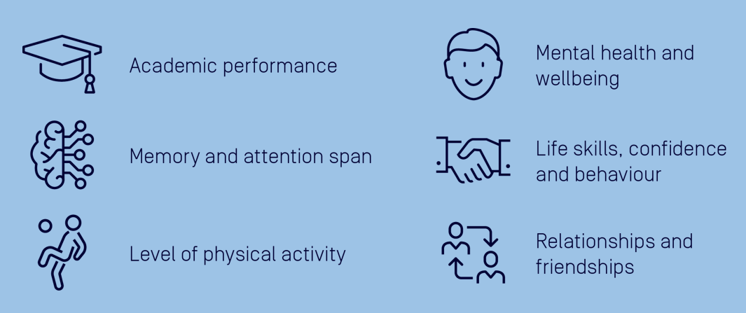
Benefits for students
Evidence shows that developing physical literacy improves students’:

Slide 6
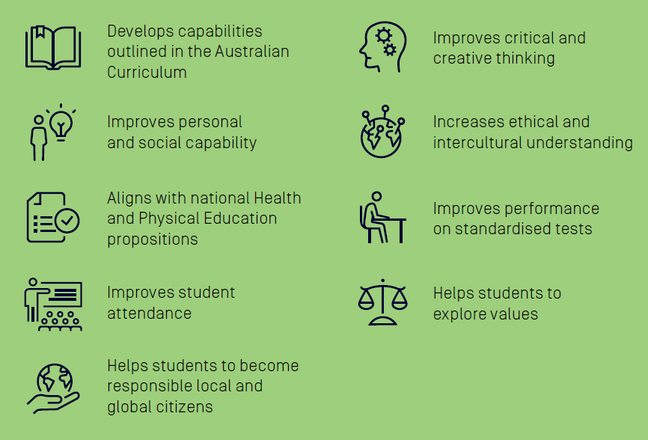
Benefits for schools
Physical literacy delivers curriculum and school priorities.

Slide 7
Alignment to national and international policy
Applying physical literacy helps our school align to:
Alice Springs (Mpantwe) Education Declaration (2019)
Australian Student Wellbeing Framework
UNESCO: Quality Physical Education Guidelines for Policy Makers
OEDC: The Future of Education and Skills.

Slide 8
How we can embed physical literacy
Use the Physical Literacy: Guide for Schools as the key resource to help identify what your school currently does well and opportunities to build a strong physical literacy culture.
Consider each component of the Guide:
Leadership
Policy
Environment
Quality health and physical education program
Inclusive co-curricular program
Cross-curricular approach
Families
Local communities
Change can take time so expect incremental improvement.

Slide 9
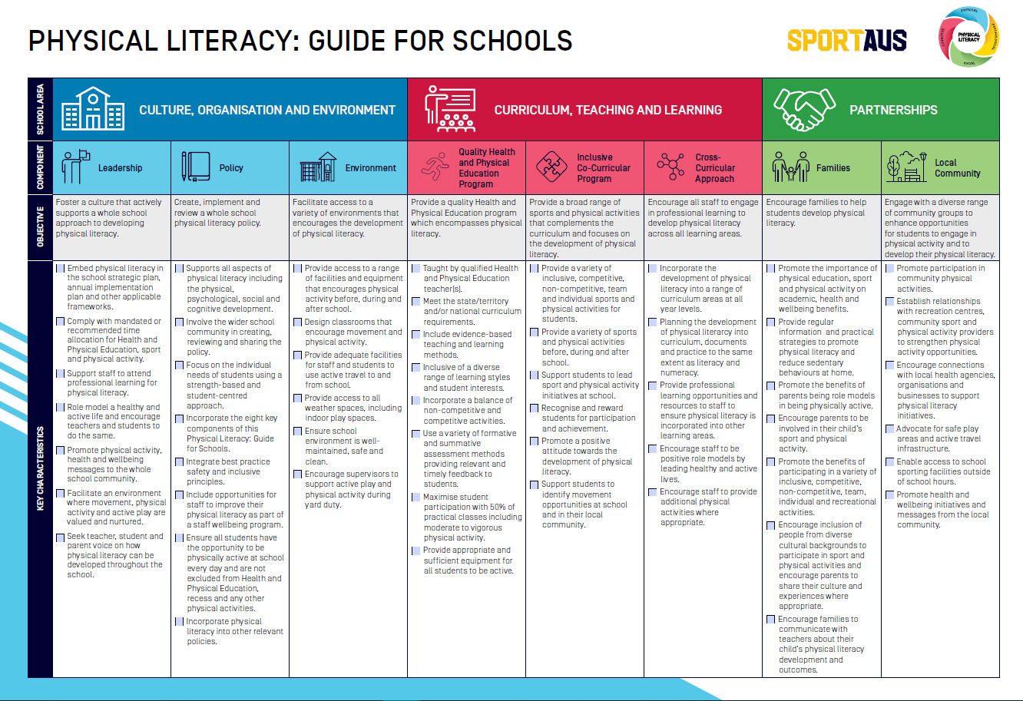

Slide 10
How to embed physical literacy
Use the Physical Literacy Implementation Plan to help guide you through the following steps:

Slide 11
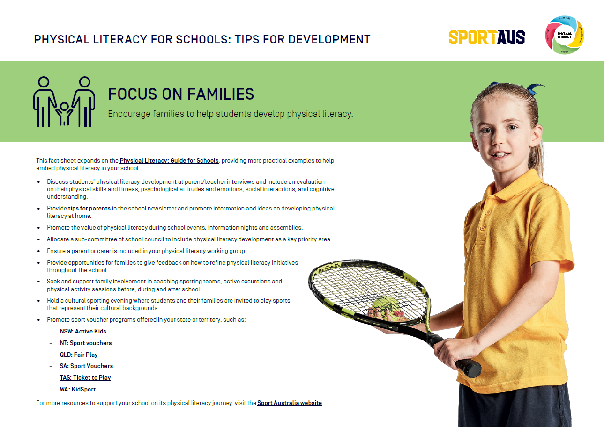
Tips for development
Fact sheets on each component of the Guide include a wealth of practical ideas for embedding physical literacy in your school. Here is a selection:

Slide 12
Summary
What are the benefits of providing a strong physical literacy culture in our school?
What support will the school provide to help embed physical literacy in our school?
What action can we take now and in the future?
Who will be responsible for leading the approach?

