Slide 1


Notes:
Instructions:
Right click on ‘your photo here’
Click on ‘change picture’
Select ‘from a file’
Choose your image
Resize your image as needed
Repeat steps for ‘your logo’
Go to file → export → JPEG

Slide 2
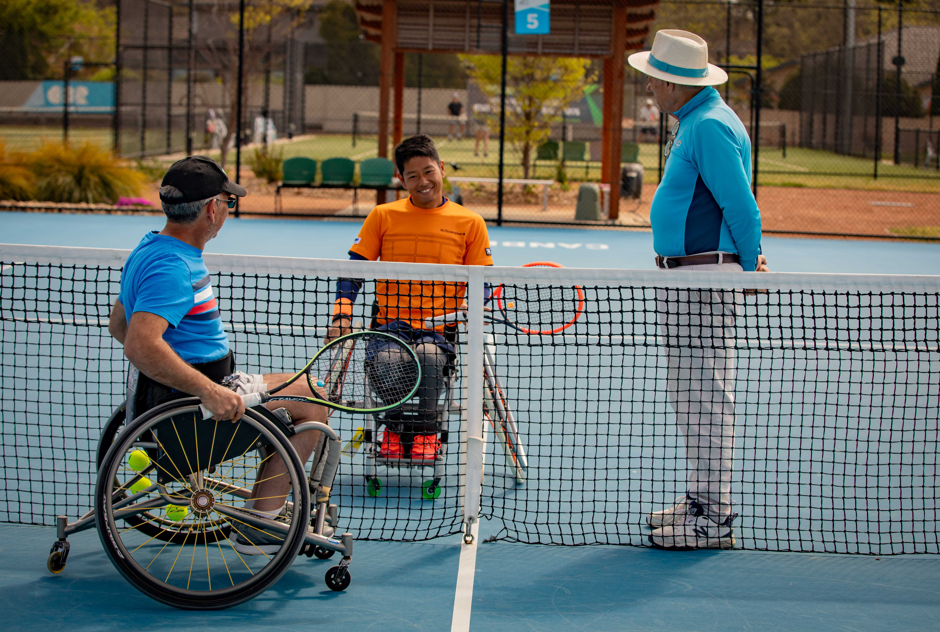


Slide 3


